Slide 1
ASPLOS’22 CCF-A
GenStore: A High-Performance In-Storage Processing System for Genome Sequence Analysis
Nika Mansouri Ghiasi¹ Jisung Park¹ Harun Mustafa¹ Jeremie Kim¹ Ataberk Olgun¹ Arvid Gollwitzer¹ Damla Senol Cali² Can Firtina¹ Haiyu Mao¹ Nour Almadhoun Alserr¹ Rachata Ausavarungnirun³ Nandita Vijaykumar⁴ Mohammed Alser¹ Onur Mutlu¹
1ETH Zürich 2Bionano Genomics 3KMUTNB 4University of Toronto
Reporter：Zhenhua Zhao Date：2023.3.14

Slide 2
Outline
Background
Motivation Studies
GenStore Design
Overview
GenStore-EM for Exactly-Matching Reads
GenStore-NM for Non-Matching Reads
GenStore Flash Translation Layer (FTL)
Evaluation
Related Work

Slide 3
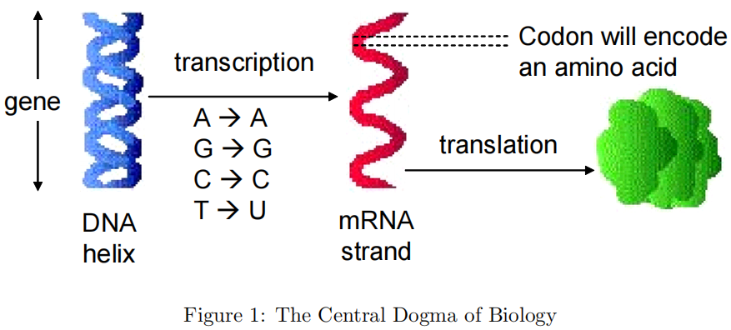
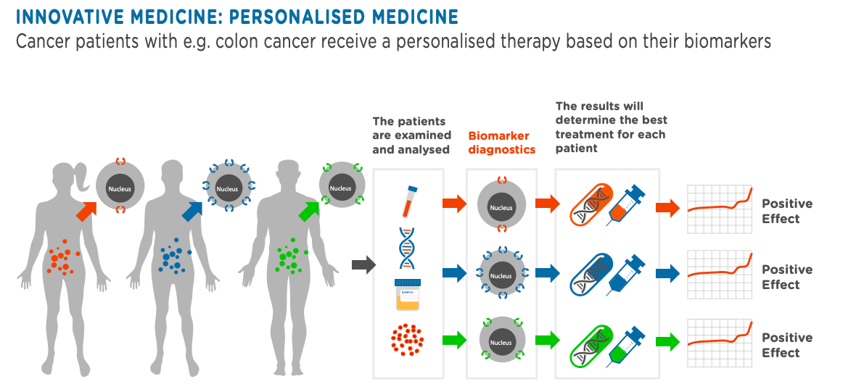
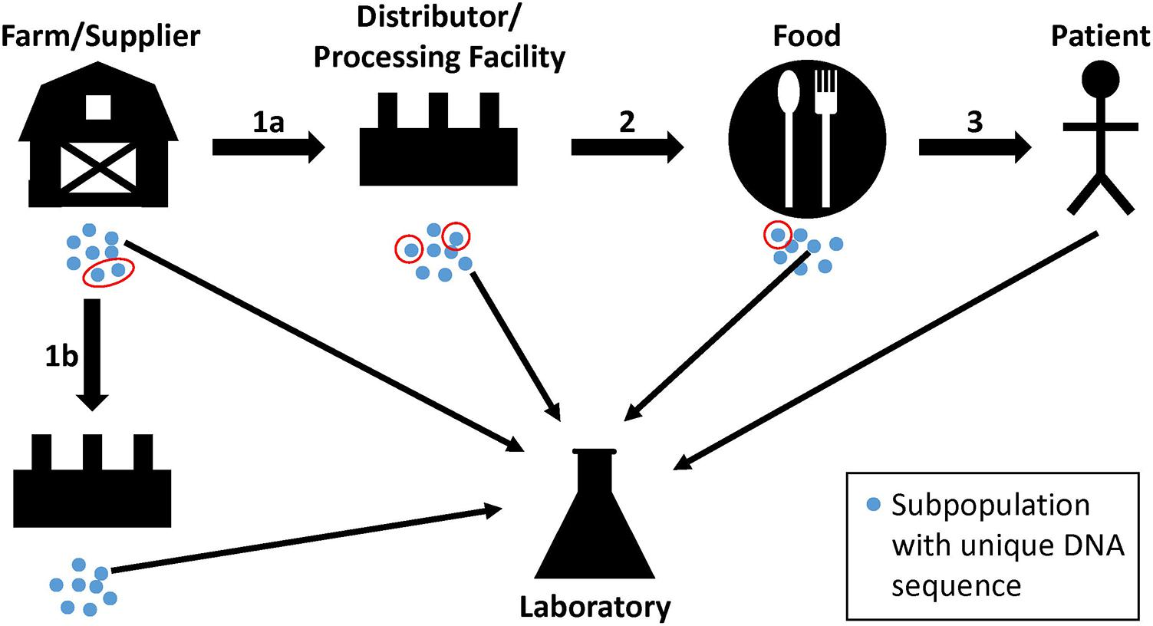
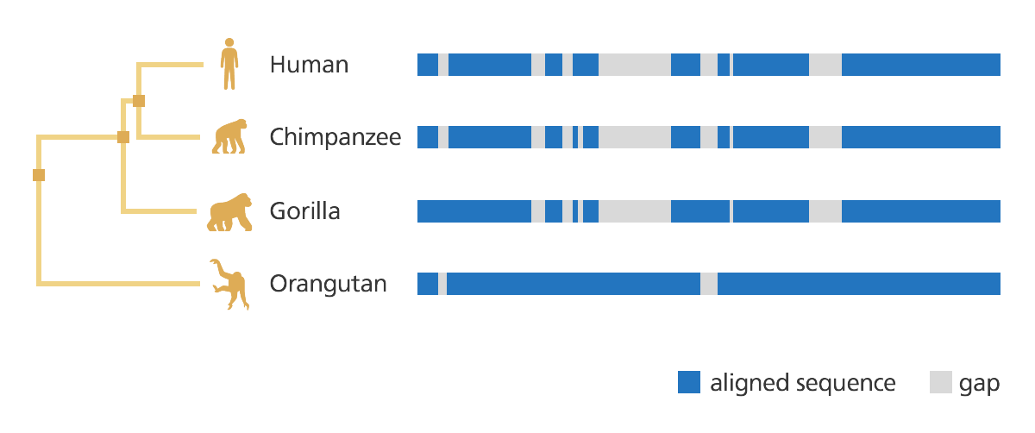
Background
Central Dogma of Biology
Usage of Genome Sequence Analysis
碱基(AGCT)
双螺旋
结构
DNA
转录
RNA
翻译
生命
活动
调控
蛋白质
Personalized medicine
Outbreak tracing
Evolutionary studies

Slide 4
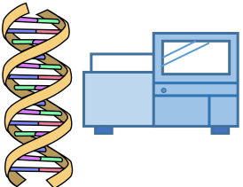
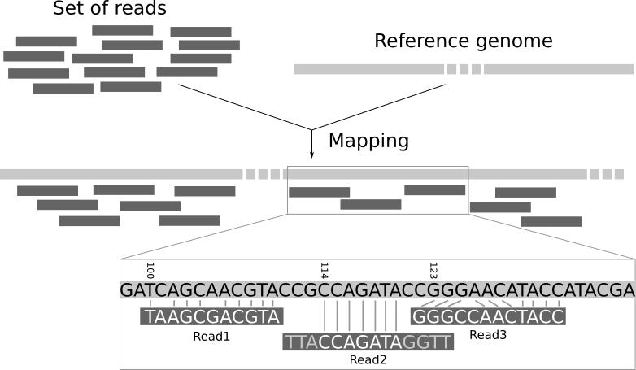
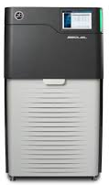
Background
Read mapping：first key step in genome sequence analysis
Aligns reads to potential matching locations in the reference genome
For each matching location, the alignment step finds the degree of similarity (alignment score)
Require large amounts of computationally-expensive approximate string matching (ASM) computation between reads and the reference genome due to:
- Sequencing errors and Genetic variation
②basecalling
generate millions randomly sampled, inexact sub-strings of the original genome, called reads
③Read mapping
Short read
accuracy：99-99.9%
10² DNA base pairs
①collection, preparation, and sequencing of a DNA sample in the laboratory
Long read
accuracy：85-90%
10³ ~10⁶ DNA base pairs
Human full DNA
3.2×10⁹ DNA base pairs

Slide 5
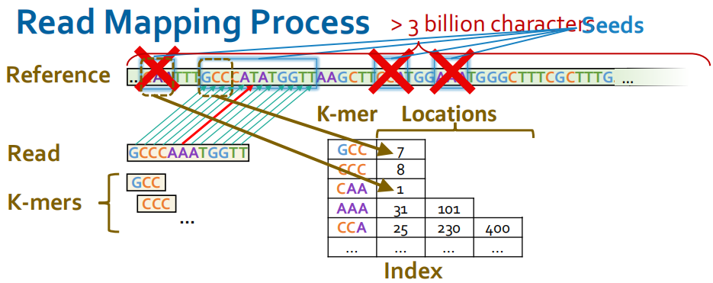
Background
Read mapping Process
GenStore: Filter reads that do not require alignment inside the storage system
For reference gene sequence: Build k-mer Index
For short reads:
Seeding: Determine potential matching locations (seeds) in the reference genome
Seed Filtering(Chaining): Prune some seeds in the reference genome
Alignment: Determine the exact differences between the read and the reference genome

Slide 6
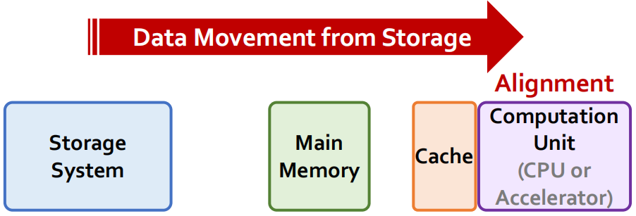
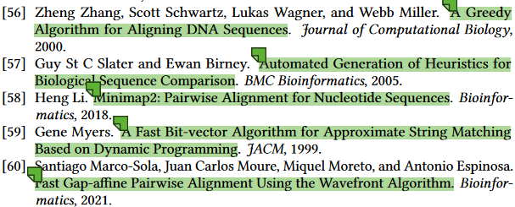
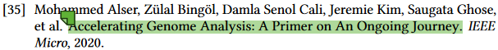
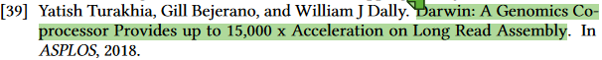
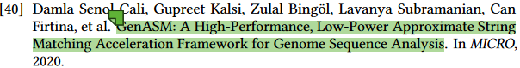
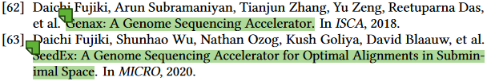

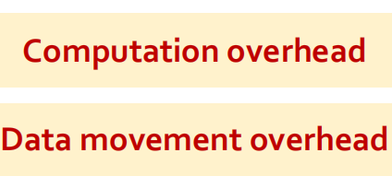
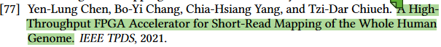
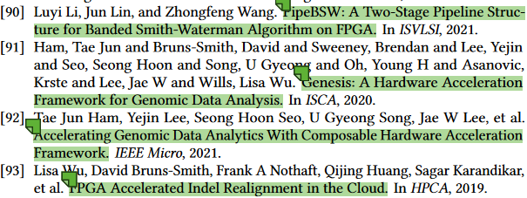
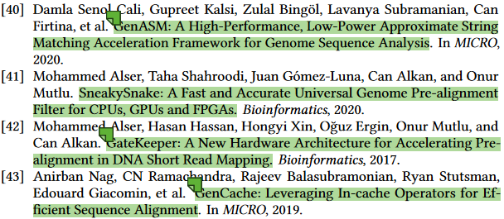
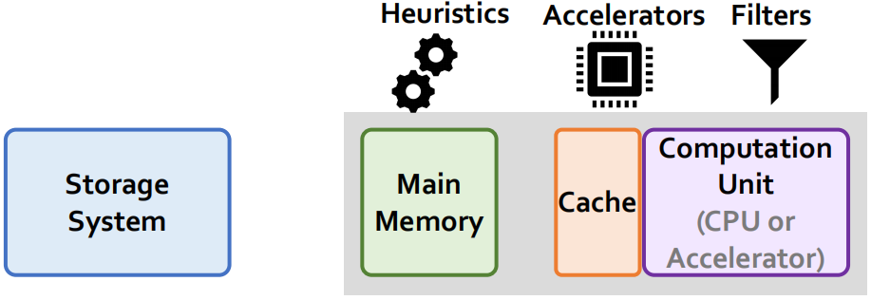
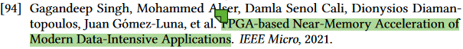

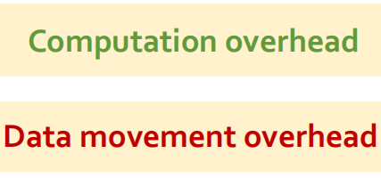
Background
Prior works on optimizing Genome Sequence Analysis
heuristics ASM
prior works
hardware accelerators
Ignore the I/O cost that most systems must pay to read the large amount of data from the storage system to main memory and computation units.
filters(prune reads that do not require expensive computation)

Slide 7
Motivation Studies
Perform experimental studies to understand the potential of efficient in-storage accelerators for improving the performance of genome sequence analysis applications.
Read mapping systems | Optimization technique | Evaluation Platform
Minimap2 | Baseline | AMD EPYC 7742 CPU with 1TB DDR4 DRAM
SW-filter | Filter out exactly-matching reads using SIMD
Ideal-ISF | In-Storage Filter (ISF) can concurrently filter out exact-matching reads inside the SSD Host CPU performs read mapping for nonfiltered reads | Simulation environment
ACC | Hardware accelerator GenCache
Ideal-ISF+ACC | ISF filtering out exactly matching reads inside the SSD ACC performs read mapping for non-filtered reads

Slide 8
Motivation Studies
To assess the impact of the storage subsystem on end-to-end application performance, we evaluate each of the five systems with four different configurations.(we do not evaluate DRAM for Ideal-ISF and Ideal-ISF+ACC since using in-storage processing is contradictory to pre-loading all the data to main memory)
Configuration | Interface | Internal/External bandwidth Ratio
Low-end SSD (SSD-L) | SATA3 interface | 8 channels×1.2GB/s / 500MB/s = 19.2×
Mid-end SSD (SSD-M) | PCIe Gen3 M.2 interface | 16 channels×1.2GB/s / 3.5GB/s = 5.48×
High-end SSD (SSD-H) | PCIe Gen4 interface | 16 channels×1.2GB/s / 7GB/s = 2.74×
Idealized System | Data pre-loaded to DRAM | -

Slide 9
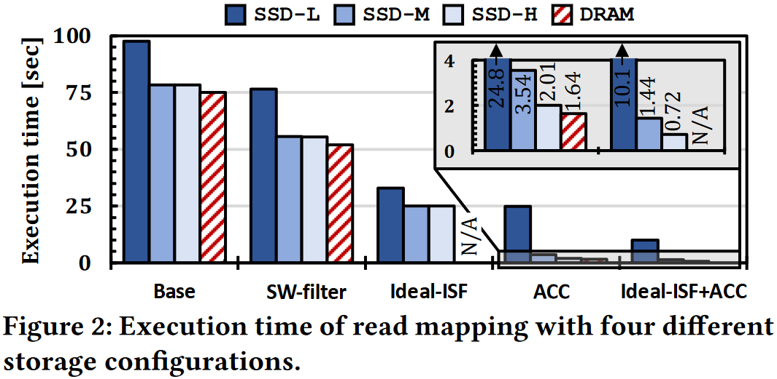
Motivation Studies
Results & Analysis
Observation
Filtering outside SSD provides lower performance benefit because it
1) does not reduce the data movement overhead
2) must compete with read mapping for system resources
A HW accelerator reduces the computation bottleneck, which makes I/O a larger bottleneck in the system.

Slide 10
GenStore
The key idea
Exploit low-cost in-storage accelerators to accurately filter out the reads that do not require the expensive ASM computation in read mapping, thereby significantly reducing unnecessary data movement from the storage system to main memory and processors.
Two Challenges
Read mapping workloads exhibit fundamentally different behavior, due to:
read length and error rates
the genetic variation of reads compared to the reference genome
Existing filtering methods incur a large number of random accesses to large datasets
NAND flash-based SSD with poor random-access performance and limited size of internal DRAM.
Solution
Two different filter accelerators
Replace expensive random accesses with more efficient sequential accesses to storage devices
Data placement inside the storage device that takes full advantage of the high internal SSD bandwidth to concurrently access large amounts of genomic data.

Slide 11
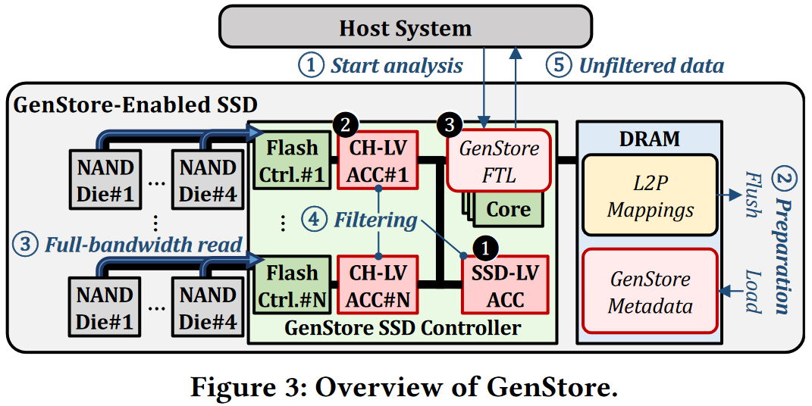
GenStore
Overview
① a single SSD-level accelerator (comparator )
② channel-level accelerators, each of which is dedicated to a channel (indexing,chaining PE)
③ The GenStore-FTL communicates with the host system and manages the metadata and data flow over the SSD hardware components

Slide 12
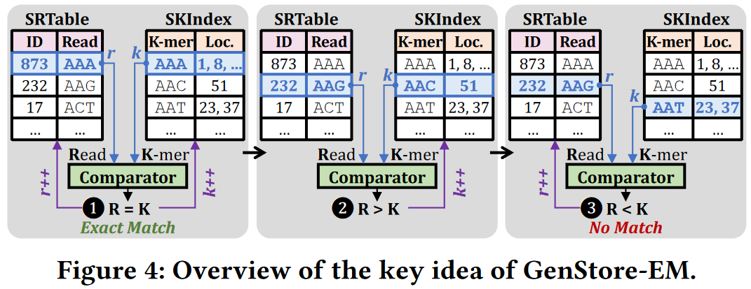
GenStore
GenStore-EM for Exactly-Matching Reads: accelerate read mapping by using an efficient in-storage filter for reads that have at least one exact match in the reference genome.
Key Idea:sequentialize most data accesses via a carefully designed metadata structure and data layout. To do so, we design a new sorted, read-sized k-mer index structure.
SRTable：each entry stores a read and its unique ID
SKIndex：contains all unique readsized k-mers of the reference genome, along with each k-mer’s corresponding locations in the reference genome.

Slide 13
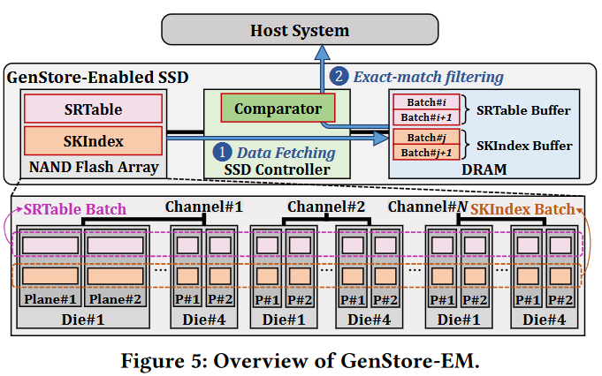
GenStore
Overall operational flow of GenStore-EM, which consists of two steps:
Step 1. data fetching (in batched manner, double buffering)
Step 2. exact-match filtering(using simple comparator logic in the SSD-level accelerator)
Steps 1 and 2 are performed in a pipelined manner. During filtering, GenStore-EM sends the unfiltered reads to the host system for full read mapping. This enables the concurrent filtering of reads in the SSD and read mapping of the unfiltered reads in the host system.
Data Structure：
Strong hash value of read and k-mer
SKIndex contain k-mer hash instead of k-mer
reduce storage overhead and performance overhead of comparisions.

Slide 14
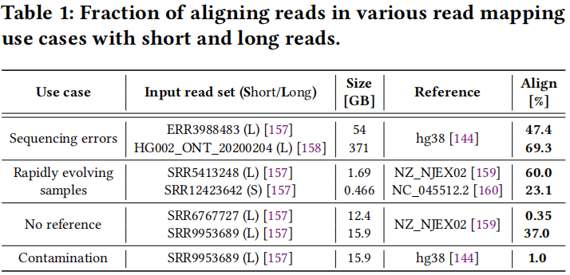
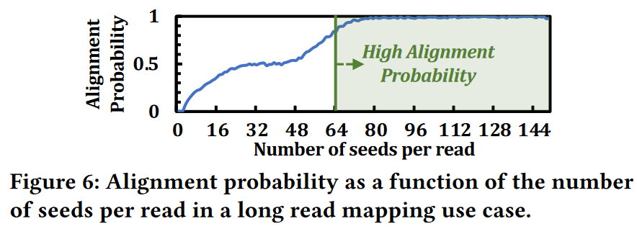
GenStore
GenStore-NM for Non-Matching Reads: filter most of the non-matching reads, i.e., reads that would not align to any subsequence in the reference genome. This is motivated by the fact that in read mapping, a large fraction of reads might not align to the reference genome
Key Idea：uses chaining to build an in-storage filter.To avoid such expensive chaining, GenStore-NM selectively performs a fast version of chaining only on reads with a small number of seeds and sends other reads to the host system for full read mapping (including complete chaining).

Slide 15
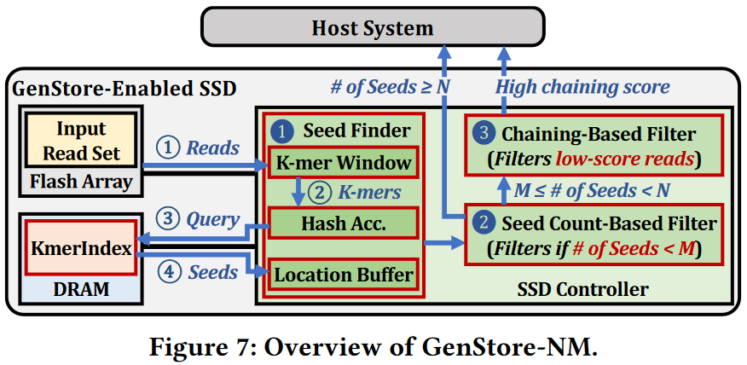
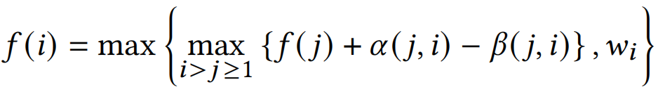
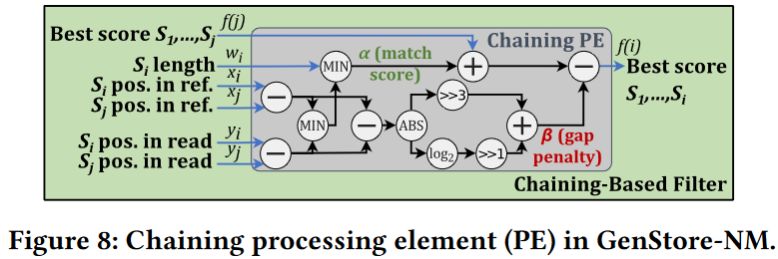
GenStore
Overall operational flow of GenStore-NM, which consists of three steps:
Step 1. reads the input read set from the flash chips, generates minimizer k-mers for each readand looks up each minimizer in a K-mer Index (KmerIndex) to find the potential matching locations
Step 2. counts the number of seeds in each read to decide if the read needs to go through chaining( also filters out reads with too few seeds)
Step 3. filters reads based on their chaining scores using a fast and efficient chaining accelerator If a read has at least one chain with a score above a specified threshold, it is sent to the CPU for mapping
Chaining score

Slide 16
GenStore
GenStore Flash Translation Layer (FTL)
GenStore FTL Metadata：GenStore metadata includes the map_x0002_ping information of the data structures necessary for read mapping acceleration, which enables access to the data structures without the L2P mapping table of the regular FTL.
Data Placement：When each data structure is initially written to the SSD, GenStore sequentially and evenly distributes it across NAND flash chips.
SSD Management Tasks：In accelerator mode, GenStore stops working as a regular SSD. It only reads data structures to perform filtering, and does not write any new data. Therefore, GenStore does not require any write-related SSD-management tasks such as garbage collection and wear-leveling.

Slide 17
Evaluation
Base：
Minimap2 [Bioinformatics’18]: software mapper for short and long reads
GenCache [MICRO’19]: hardware mapper for short reads
Darwin [ASPLOS’18]: hardware mapper for long reads
GS-Ext：
Base integrated with an implementation of the GenStore filter without in-storage support.The goal of evaluating GS-Ext is to decouple the effects of GenStore’s two major benefits:
1) alleviating I/O bottlenecks via efficient in-storage processing
2) reducing the workload of the read mapper by filtering reads with simple operations.
GS-Ext obtains the second benefit but not the first.
GS：
Base integrated with the hardware GenStore filtering accelerators, GenStore-EM and GenStore-NM

Slide 18
Evaluation
Area and Power (We implement GenStore’s logic components in Verilog HDL.)
Implement GenStore’s logic components in Verilog HDL.
Synopsys Design Compiler
SSD power values of the Samsung 3D NAND flash-based SSD
DRAM power values based on DDR4 model
Performance Modeling (We evaluate hardware configurations using two simulators)
Ramulator for DRAM timing
MQSim for SSD timing
Data reported in the original works for GenCache and Darwin accelerators
Real System Results (We use real systems to evaluate all software configurations.)
AMD EPYC 7742 CPU
1TB DDR4 DRAM
AMD μProf

Slide 19
Evaluation
SSD Configurations
SSD-L: SATA3 interface (0.5 GB/s sequential read) (Intel SSD DC S4500 Series)
1.2 GB/s per channel bandwidth
8 channels
SSD-M: PCIe Gen3 M.2 interface (3.5 GB/s sequential read)( Samsung SSD 980 PRO)
1.2 GB/s per channel bandwidth
16 channels
SSD-H: PCIe Gen4 interface (7 GB/s sequential read) (Samsung SSD PM1735)
1.2 GB/s per channel bandwidth
16 channels
Datasets
SRR2052419 19.6 GB for motivation study
Short read experiments use hg38 human reference genome
Mason 2 genomic read simulator simulate read sets with various sizes(up to 440 GB) and different fractions of exactly-matching reads (75% and 85%)
Use the reference genome and read set from Table 1 in Section 4.3.1

Slide 20
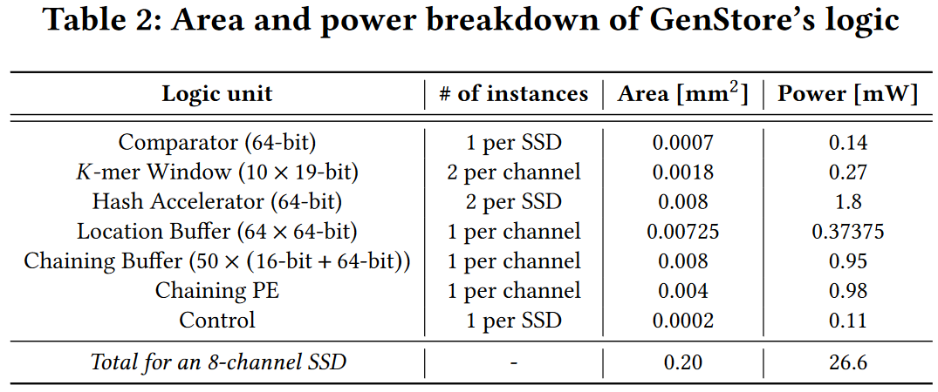
Evaluation
Area and Power Analysis
The total hardware area needed for GenStore is very small (0.20 mm² at 65 nm and 0.02 mm² at 14 nm, only 0.006% of a 14nm Intel Processor). The area overhead of GenStore hardware (0.06 mm² at 32 nm) is less than 9.5% of the three 28nm ARM Cortex R4 processors in a SATA SSD controller.

Slide 21
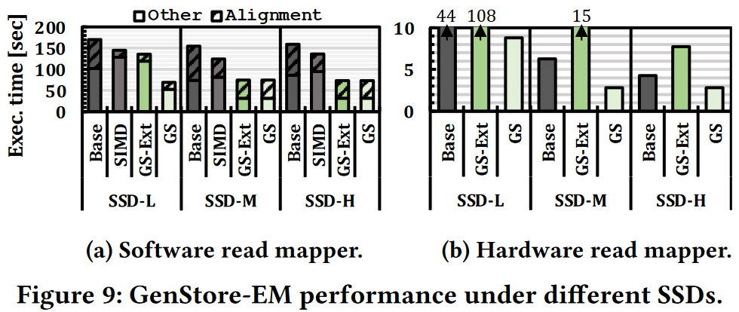
Evaluation
GenStore-EM Analysis (22-GB short read and 80% of reads exactly match)
Integration with a Software Read Mapper：1) Base (Minimap2 ), 2) SIMD, an extension of Base with a SIMD implementation of a baseline exactly-matching read filter using 128-bit SIMD instructions, 3) GS-Ext, and 4) GS.
Integration with a Hardware Read Mapper：1) Base (GenCache), 2) GS-Ext, and 3) GS.

Slide 22
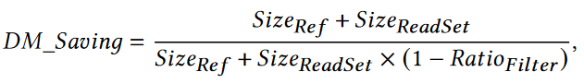
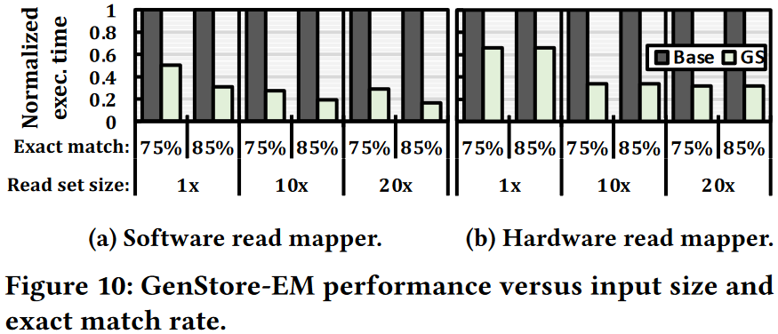
Evaluation
GenStore-EM Analysis
Effect of Read Set Features on Performance：evaluate GenStore-EM while changing two key characteristics: 1) the input read set size and 2) exactly matching read rate.
SSD-H

Slide 23
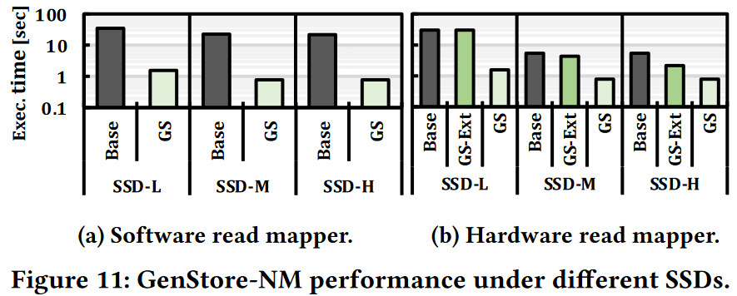
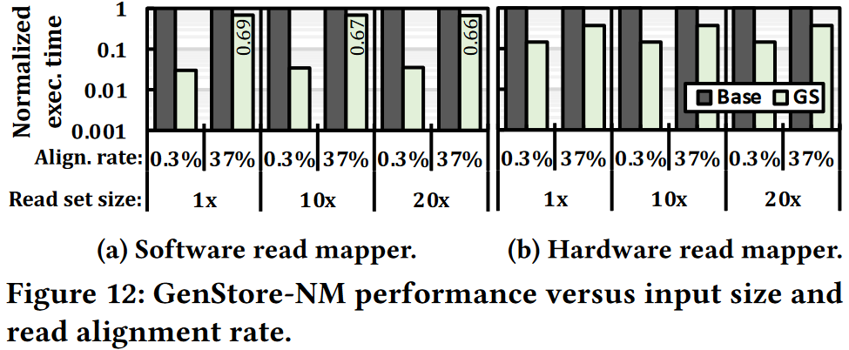
Evaluation
GenStore-NM Analysis：(12.4-GB read set with 99.65% of reads not aligning)
Integration with a Software Read Mapper:1) Base (Minimap2), 2) GS
Integration with a Hardware Read Mapper: 1) Base (Darwin), 2) GS-Ext, 3) GS.
Effect of Read Set Features on Performance:1) input read set size, 2) alignment rates
SSD-H

Slide 24
Related Work
Accelerating Read Mapping
non-filtering approaches
accelerate one or more non-filtering steps of read mapping (e.g., seeding and approximate string matching) using hardware accelerators. (processing-in-memory、GPUs、FPGAs、ASICs)
filtering approaches
accelerate the pre-alignment filtering step of read mapping. These works provide highly-parallel read filtering heuristics that quickly eliminate dissimilar sequences before invoking computationally-expensive alignment algorithms. (processing-near-memory、FPGAs、GPUs、CPUs)
In-Storage Processing Systems
Form：
application-specific accelerators
general-purpose processing inside storage devices
SSDs closely integrated with FPGAs
SSDs closely integrated with GPUs
(None of these works perform in-storage filtering for read mapping to accelerate genome sequence analysis.)

Slide 25
Thank you!

Slide 26
seeding
collection, preparation, and sequencing of a DNA sample
basecalling
read mapping
seed filtering
chaining
identifies potential matching locations of each read with respect to a known reference genome
images or
electric current
reads:sequences
of nucleotides
sequence
alignment

Slide 27
